Slide 1
Payseur Lab Meeting 7/17/19
April Peterson
Research updates

Slide 2
(aim3) Comparison of PWD and KAZ (bivalent patterns)
Outline / part of chapter 3
(sexual dimorphism in meiotic features (explain features)
Start analysis on males from PWD and KAZ (since these are the most interesting / divergent)
Notes:
Aim 3 examine patterns for CO number and position
Background
-meiotic features (how does this connect to hetC)
PWD and KAZ male patterns (connect back to HetC)
Canonical male and female landscapes
Predictions, for ‘landscape’ differences given the MLH1 differences

Slide 3
Initial MLH1 results
PWD
MSM
KAZ
Notes:
30 vs 23

Slide 4
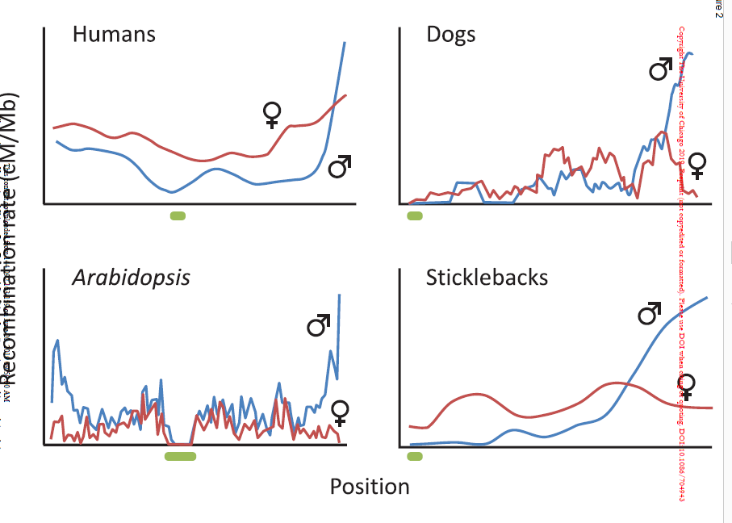
Canonical male Rec Landscape
Do the parts of male landscape differ across these strains?
Sardell and Kirkpatrick, 2019, American Naturalist
Notes:
Goal
Review male landscape
-- applies across all chromsomes in genome,

Slide 5
Feature | Prediction (based on MLH1 count) | Justification / model | Different within cell (bins)? | Supported?
SC Length | Longer in PWD | Chromosome Axis
Chrm Classes | More 2COs in PWD | (math) | (SC ~ CO number)
InterFocal Distance (IFD) (Interference) | Shorter in PWD (weaker inference) | (interference-fit | (IFD could vary across bivalent lengths)
CO Position 1CO 2CO | PWD | ? (interference / regional bias) ? | Yes, shrter chrms will be closer to uniform
Telomere bias / centromere supression
Notes:
Review the initial predictions across traits
Careful not to make too busy
Male landscape?

Slide 6
Curated auto bivalent Data (BivData)
Histogram, average biv number per cell
1. DNACrossOver
2.
3. Manual curation
(Curated-Auto) | PWD | KAZ
Mice (7-12 weeks) | 4 | 3
Cells | 64 | 73
Auto-Bivalents (Total Expected, 19*73) | 542 (1216) | 740 (1387)
(+hand measures)
(N.cells with all bivs)

Slide 7
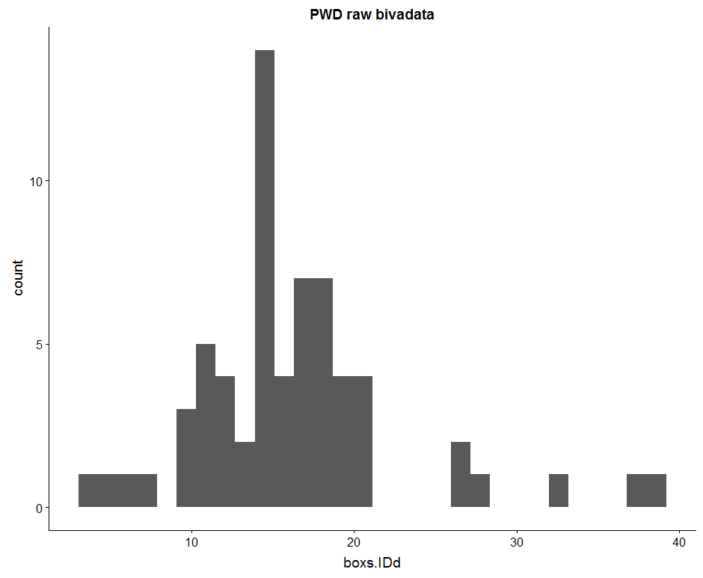
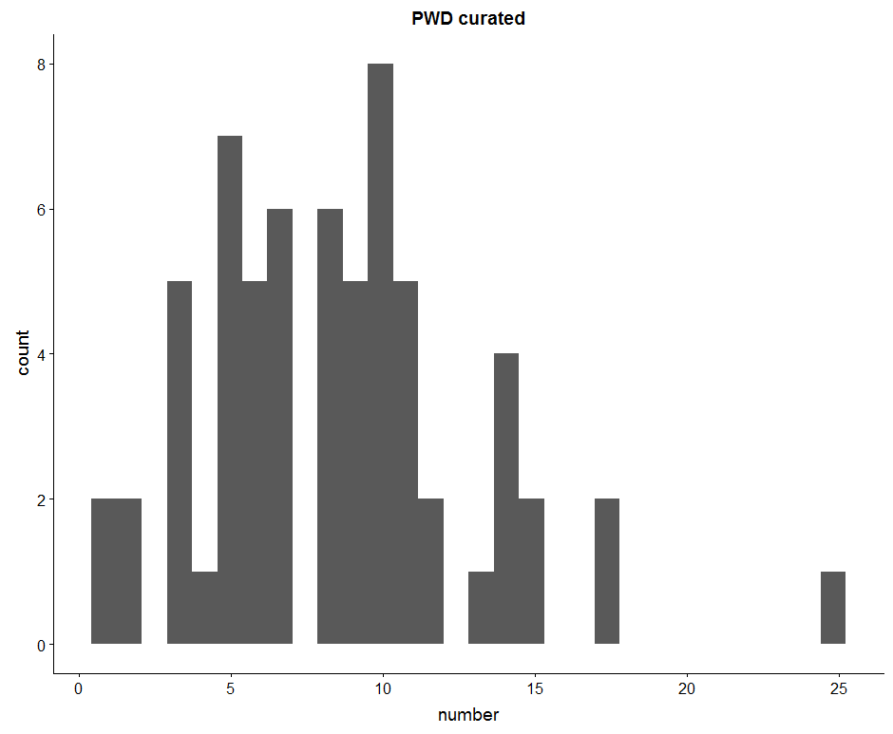
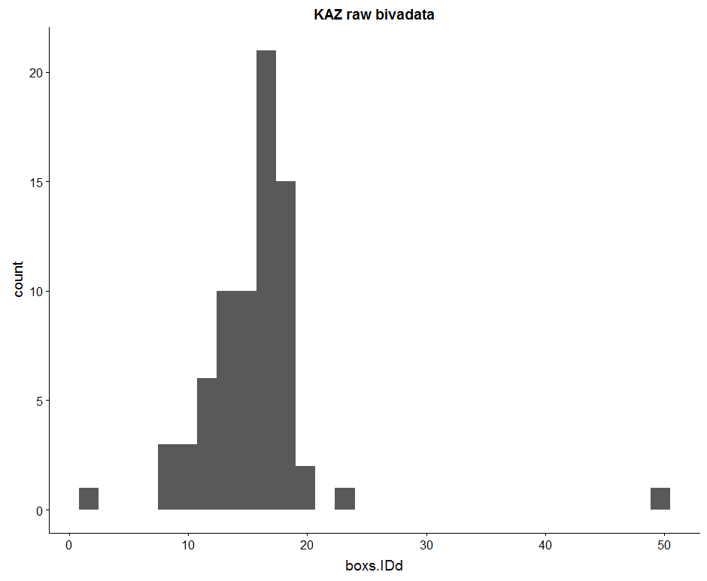
Histograms of automated data
(average number of bivalents automated per cell)
Counts of Bivalent (objects per cell)
19 autosomes per cell
Notes:
Goal
In the automated data, most cells are missing some bivalent measures. Expected bivalents measures is 19 (all autosomes)
Without 19 biv measures per cell, can’t use the rank to separate bivalents
So, making more manual measures of bivalents which were skipped by the automated
(go into process of manual measures?)

Slide 8
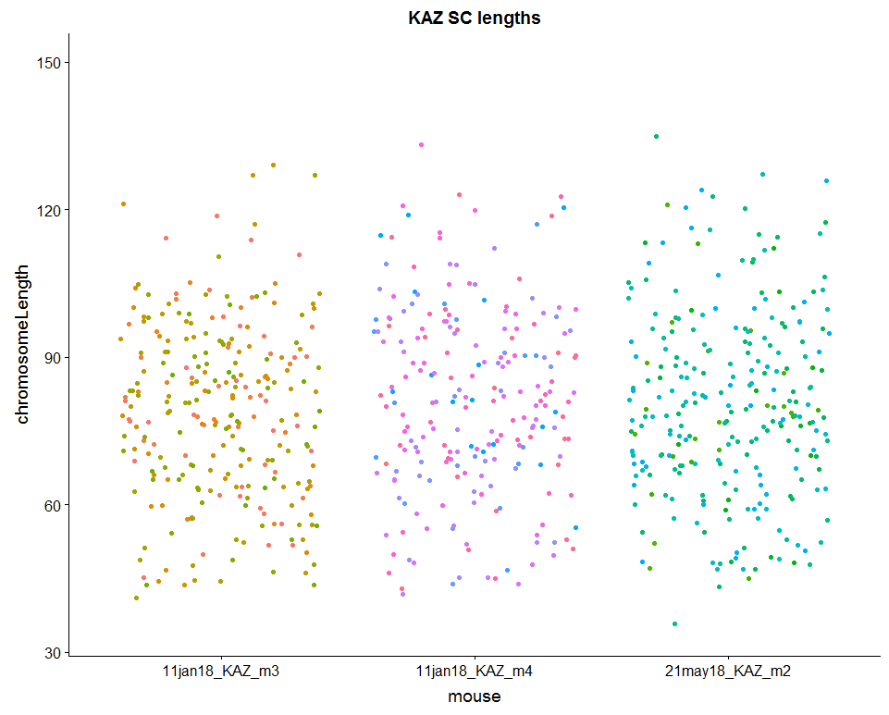
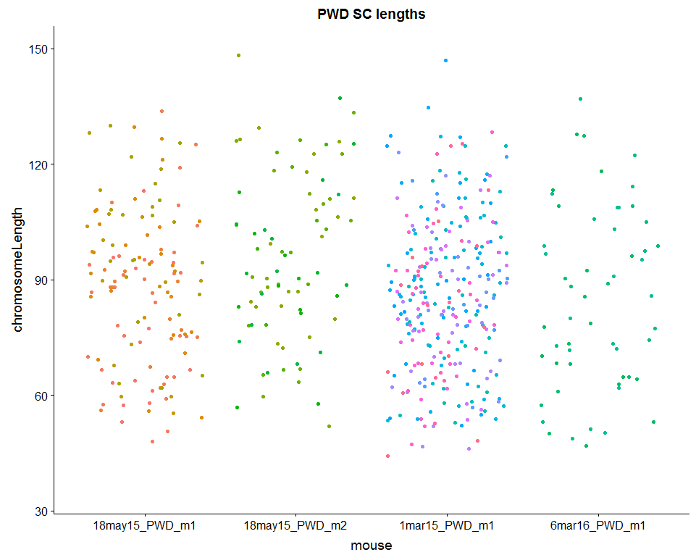
PWD have longer SC lengths
M1 – 88.3
M2 – 95.75
M1 – 86.19
M1 – 84.96
M3 –78.86
M4 – 80.99
M2 – 80.2
Notes:
(add mean bars, to show that the average
ADD values)
Make a list of young PWD to run through Cyverse again
t.Test of all observations
p-value = 2.285e-12

Slide 9
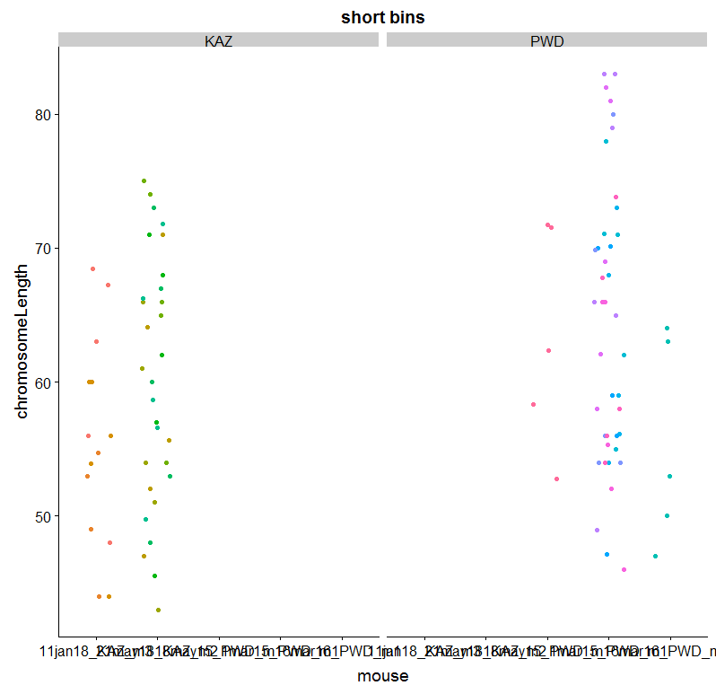
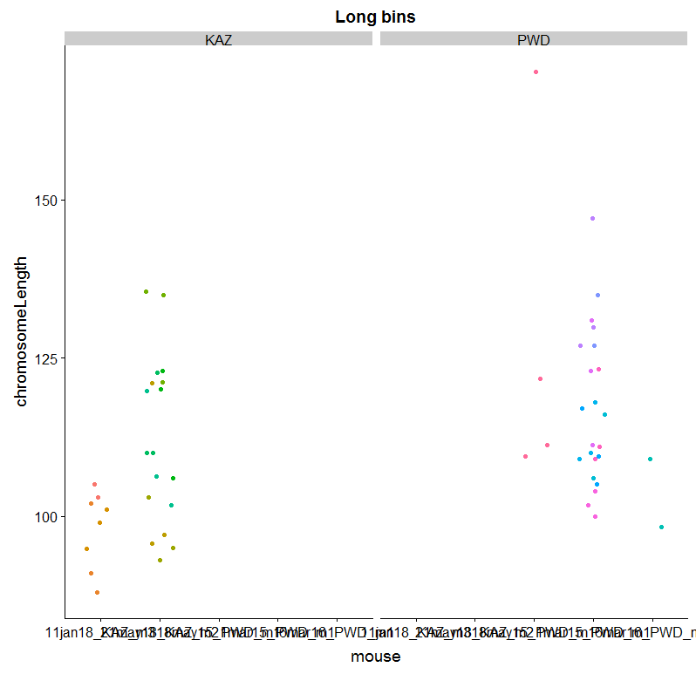
Binned, SC lengths (from each cell take the shortest and longest 5)
p-value = 0.01495
#p-value = 0.02131
Notes:
(when use more comparable measures – short and long bins of bivalents
The difference is less significant)

Slide 10
Number of cells
All data | PWD | KAZ
1CO | 93 | 178
2CO | 83 | 25
3CO | 2 | 1
Whole cells | PWD | KAZ
1CO | 88 | 132
2CO | 91 | 24
3CO | 2

Slide 11
Interference, Interfocal Distances
Raw Interfocal Distance (IFD) can be similar and normalized is different. (rbar values would be different, telomere/centromere bias might be different)
noting the normalized IFD accounts for differences between different sized chromosomes.
Notes:
(review difference between nrm and

Slide 12
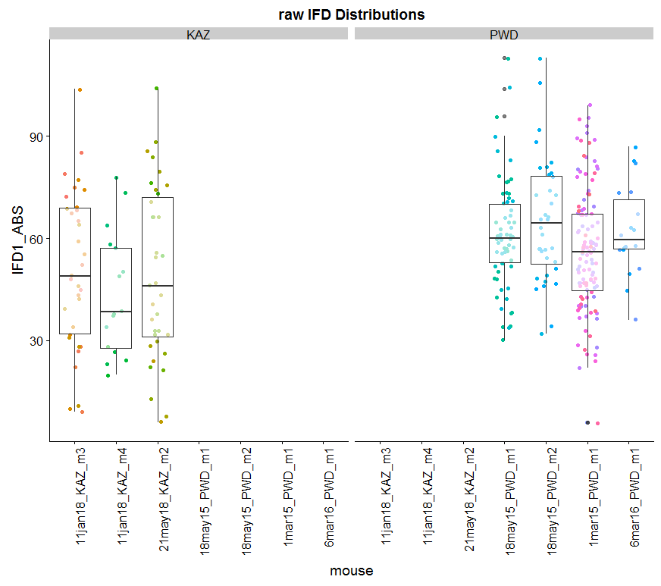
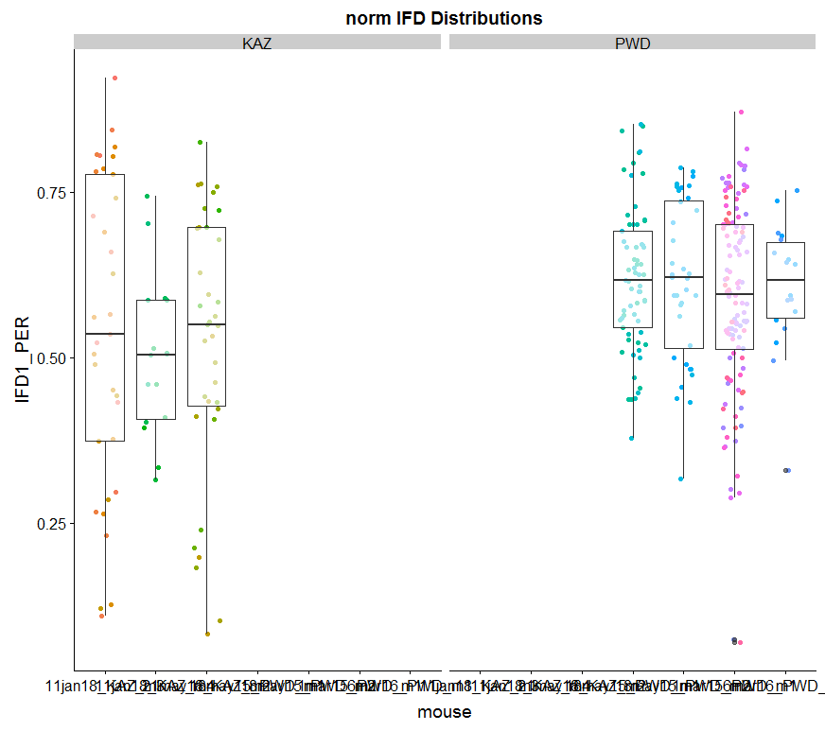
Notes:
KAZ the average IFD distance is 50% of bivalent
PWD the average IFD is ~60%
How much of an effect does subsampling have

Slide 13
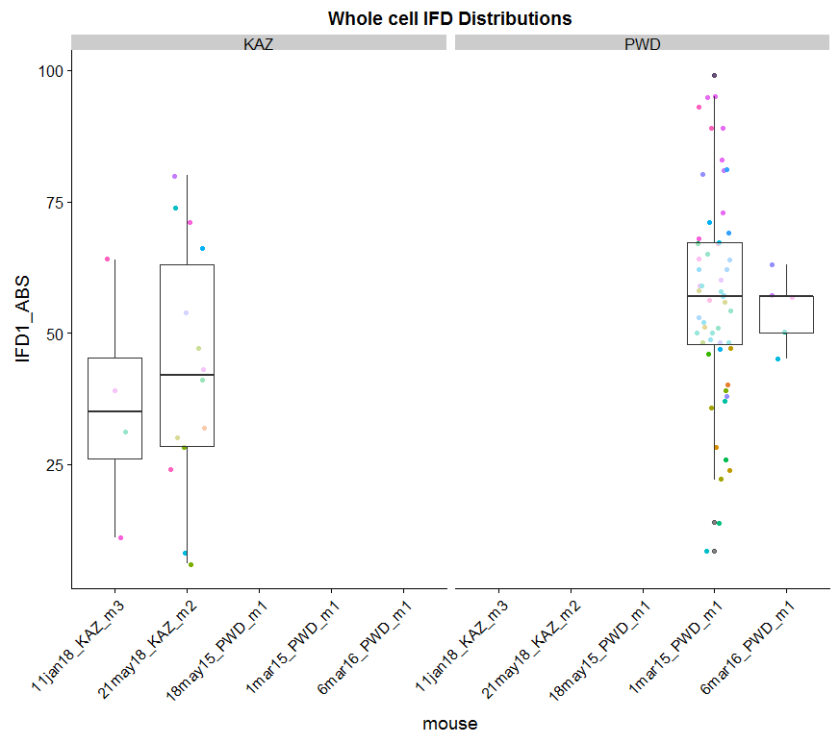
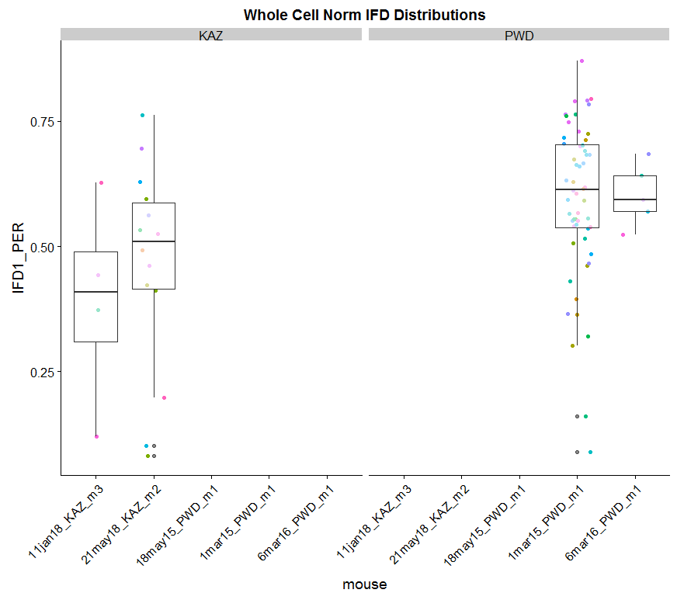
Notes:
I should just compare the 2 mice with most observations
KAZ, average IFD distance is 50% or less of total bivalent

Slide 14
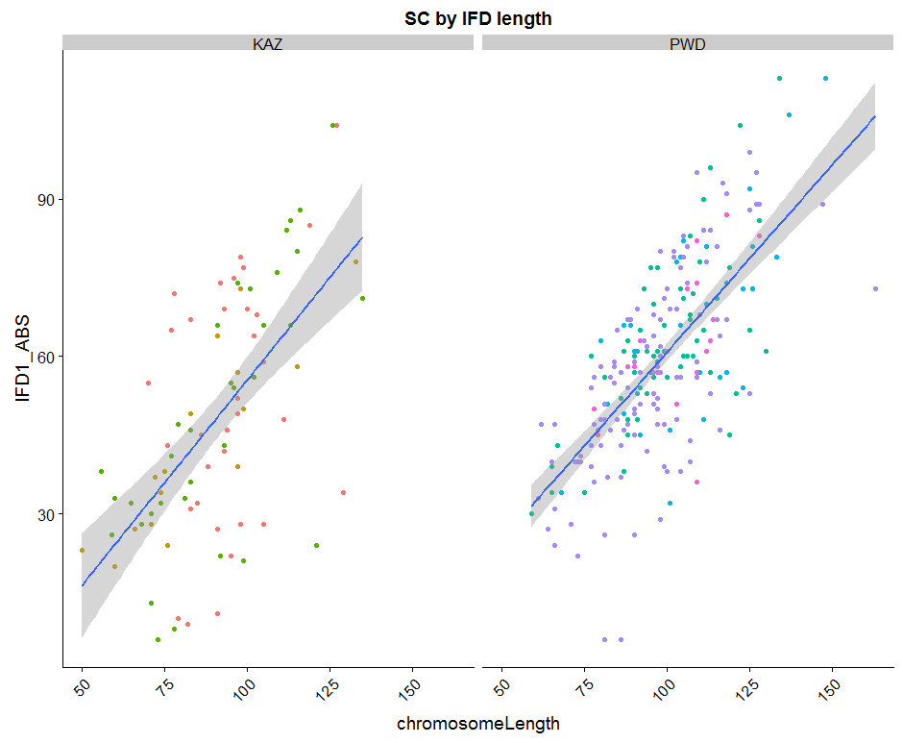
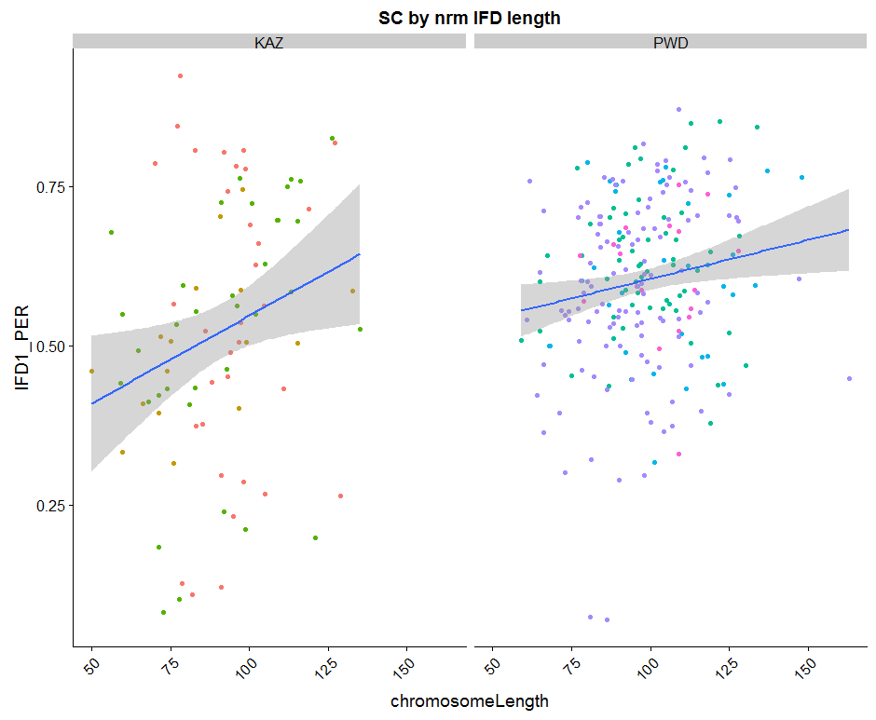
Notes:
The ranges of normalized IFDs is smaller
Weak slope for IFD.PER and SC length in PWD indicates weaker SC ~ IFD.PER relationship. No matter what the length of Biv in PWD, IFD will be arounf the mean
Stronger slope for KAZ indicates that shorter bivs have shorter nrm IFDs, and longer bivalents have longer nrmIFDs.
The range for the PER/nrm is larger in KAZ,
Larger variance for KAZ for IFDs (Stronger interference in KAZ)
nrmIFD is more consistent in PWD, and more dynamic (across bivalents) in KAZ
<try dividing up by chrm size bins>

Slide 16
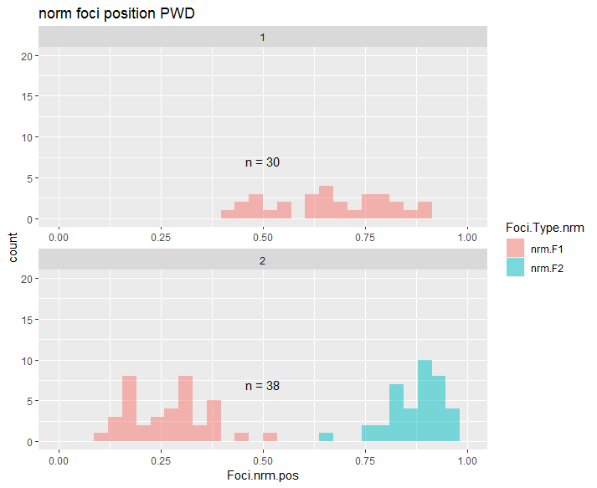
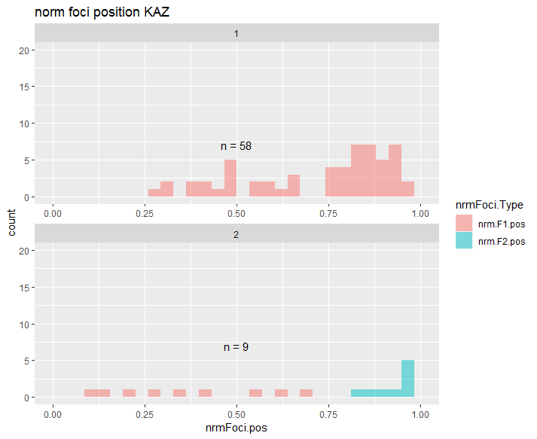
Notes:
Subsampled the KAZ data to a similar sample size
(PWD has longer SC)
(PWD have more 2COs)

Slide 17
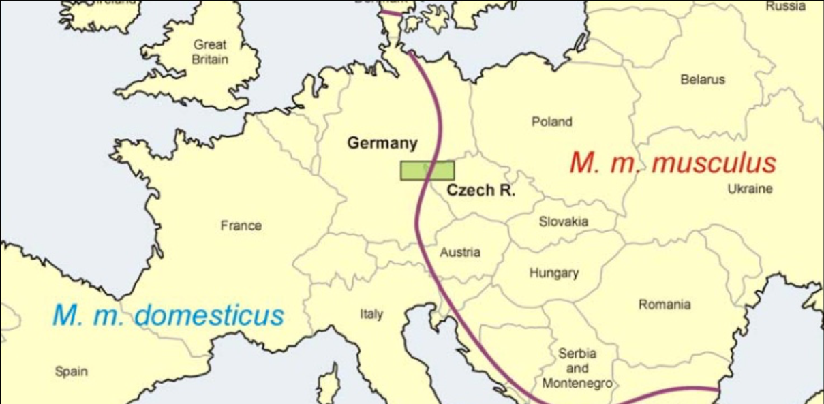
Sampling of M. m. musculus
SKIVE
KAZ
CZECH II
PWD, PWK
https://natureecoevocommunity.nature.com/users/112451-jiri-forejt/posts/33713-chromosomal-reproductive-isolation-revisited
Notes:
Point – state emphazie that looking at disparate Musc strains will be exciting / useful
(connection to evolution of Rec / HetZ) (broaden samples of Musc)
Most studied musc strains are from very close to hybrid zone
(my initial results indicate CZECHII does not have as high a RR
We got – eastern Eurasian musculus, (KAZ is actively breeding now)
Also there is a strain from Denmark – musc nuclear background and Domesticus mitochondria (apparently happened naturally)
SKIVE is a natural conplastic strain combining aM. domesticus mitochondrial genome and a M. musculus nuclear genome. Wild-derived mice are genetically distinct from common laboratory mice for a number of complex phenotypic characteristics and are valuable tools for genetic mapping, evolution and systematics research.

Slide 20
Test if these are partially accurate

Slide 21
Test the correlation between single cell measures and multi-cell measures
Notes:
7feb18_11jan18_KAZ_m4_sp1_26_rev_10

Slide 22
Test if kinks affect SC length
Notes:
26jan18_11jan18_KAZ_m3_sp1_15_rev_5

Slide 23
Target mice
 | weeks | Check Biv
18may15_PWD_m1 | 7 | Y
18may15_PWD_m2 | 7 | Y
1apr16_PWD_m3 | 7.571429 | N
6mar16_PWD_m1 | 7.857143 | N
1apr16_PWD_m1 | 8.571429 | N
1apr16_PWD_m2 | 8.571429 | N
1mar15_PWD_m1 | 11.57143 | Y
 | weeks | Check Biv
21may18_KAZ_m2 | 7
30may18_KAZ_m1 | 8.285714
30may18_KAZ_m2 | 8.285714
30may18_KAZ_m3 | 8.285714
4dec17_KAZ_m1 | 8.857143
11jan18_KAZ_m2 | 9.714286
11jan18_KAZ_m3 | 9.714286 | Y
11jan18_KAZ_m4 | 9.714286 | Y
21may18_KAZ_m1 | 10 | Y?
11feb18_KAZ_m1 | 11
Notes:
Try to make sure I have BivData from these mice

Slide 24
Use RW’s algorithm data?

Slide 25
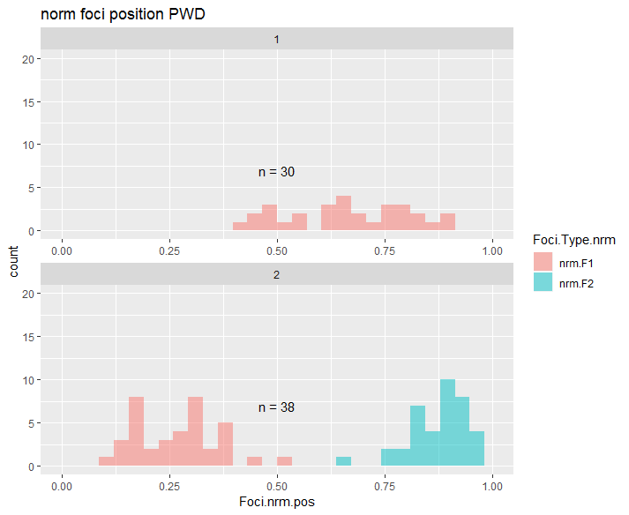
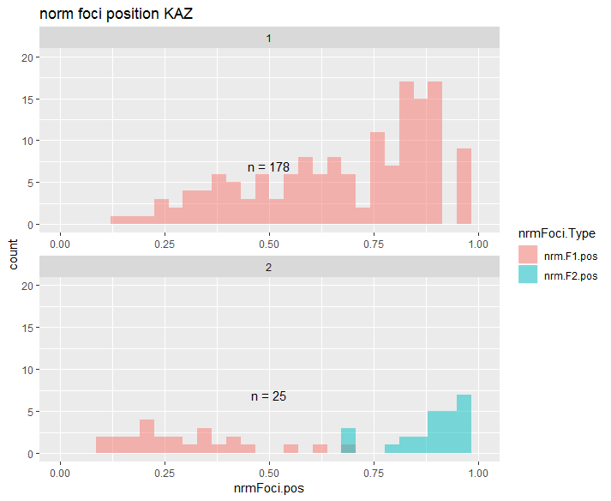
Normalized positions
Notes:
This result needs to be confirmed with more PWD data

Slide 26
Background of CO patterning
4 chromosomes, average of 8 COs per nucleus
3 phenomena of recombination positions
Obligatory CO
>1 CO per chromosome (arm)
Positive interference
Even spacing of COs
3. CO homeostasis
Nonlinear relationship between precursors and mature COs
Notes:
Example of how cells don’t look
10 COs on 4 chrms, localized on 2 chrms,
localized on 1 chrm, no spacing
Second point – even spacing across all chrms
CO spacing regulated
2) Instead what is seen are
1. even spacing
2. >1 per chrm
3. more percursors, DSBs than final CO. non linear relationship between COs and precursors
3) Three phenomena
2. 3.
Positive interference and obligatory CO thought to place a large role in the averge genome wide rate of recombination
CO homeostasis <reflects that the decision between CO and NCO acts to maintain a optimal number of COs per a cell>

Slide 27
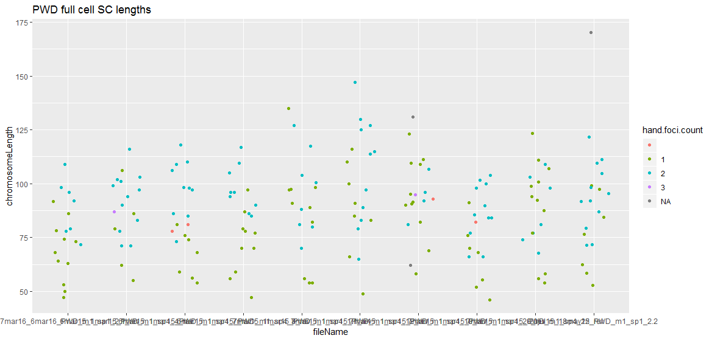
Notes:
This plot is too busy --- not sure what the point is
Within cells most

Slide 28
